Slide 1



IT-Academy training project
Project “Animals”
The Best Every team

Slide 2
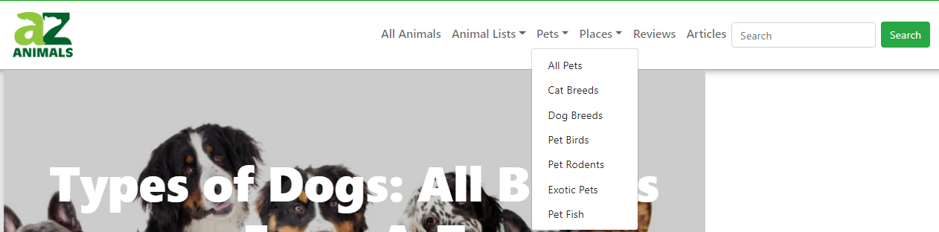

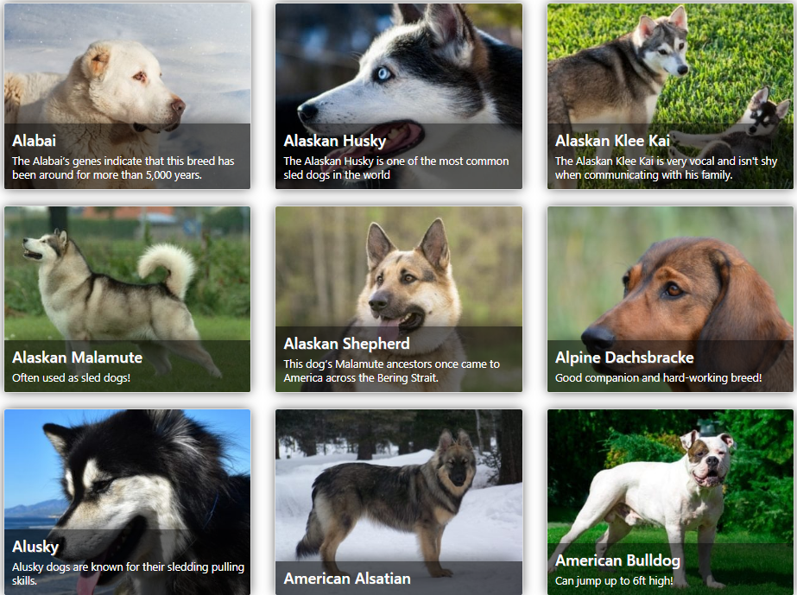
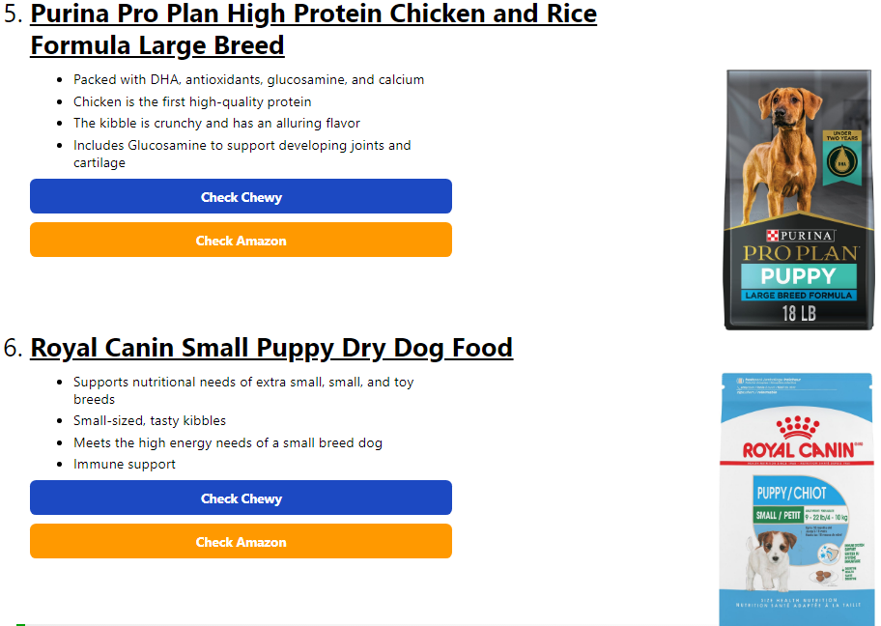
The Search is the main functionality of the site.
The source of income for maintaining the site in working order is the purchase of pet products.
This is a secondary functionality of our site.
The specificity of the site is that the site users can get to know different types of animals better, learn something new about them.

Slide 3
Web browsers for testing this website were selected based on the calculation of global usage.
Since the creator of the site is located in North America and there is no functionality for translating the site, we decided to take Google Chrome as a basis.
№ | Component name | Component role | Reference/Comment
1 | Google Chrome | Browser | 64.92% in the World
2 | Apple Safari | Browser | 9.75% in the World
3 | Microsoft Edge | Browser | 9.56% in the World
4 | Mozilla Firefox | Browser | 9.41% in the World
5 | Opera | Browser | 2.41% in the World

Slide 4
Test hardware:
№ | Role | Resource | Hardware configuration | Software configuration
1 | Client | PC | RAM: 12 GB Processor: Intel® Core™i7 CPU 2.80 GHz | Windows 10 Pro 64 bit
2 | Client | PC | RAM: 8 GB Processor: Intel® Core™ i3 CPU 1.1 GHz | macOS Big Sur v.11.6.1
3 | Client | PC | RAM: 8 GB Processor: AMD Ryzen 5 5500U CPU: 2.10 GHz | Windows 10 Home 64 bit

Slide 5
Test strategy:
The applications will be tested using a “Black box” and “Grey box” approach with partial knowledge
of the internal structure program source code.
Test methods:
Manual functional testing – is considered as the main method of the application testing.
Black Box and Grey Box are the main methods of testing by access to code.
Test types:
Functional testing
Ad-hoc testing
Exploratory testing
Testing by test-cases
Non-functional testing
Cross-browser testing
Cross-platform testing
GUI-testing
Localization testing – depends on the project
Test levels:
Smoke
Critical path.
Extended test

Slide 6
Quality and acceptance criteria:
All necessary artifacts are collected: check lists, test cases and bug reports
The product should not have known bugs with severity Critical, Major, Medium and bugs with Priority ASAP, High, Normal at the time of finish testing
Critical success factors:
Software accessibility (Jira, Xray)
Test environment (Browsers, PC with OC Version)
Strategic focus (Management, Planning, Communication, Priority setting)
Team members availability
Web-site availability

Slide 7
Testing schedule:
№ | Activity | Start date | End date | Responsible
1 | Test plan creation | 08.23.2022 | 08.24.2022 | Dmitry Luk
2 | Check-list creation | 08.23.2022 | 08.26.2022 | Elena Pavlyukevich Luk Dmitry Raukach Siarhei
3 | Test cases creation | 08.27.2022 | 09.04.2022 | Elena Pavlyukevich Luk Dmitry Raukach Siarhei
4 | Testing | 09.05.2022 | 09.09.2022 | Elena Pavlyukevich Luk Dmitry Raukach Siarhei
5 | TRR | 09.10.2022 | 09.11.2022 | Elena Pavlyukevich Luk Dmitry Raukach Siarhei

Slide 8
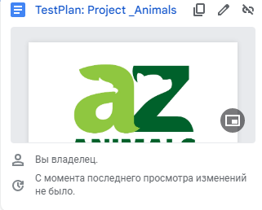
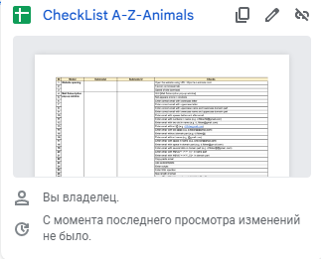
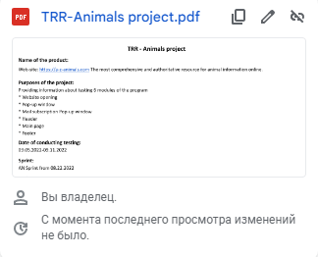
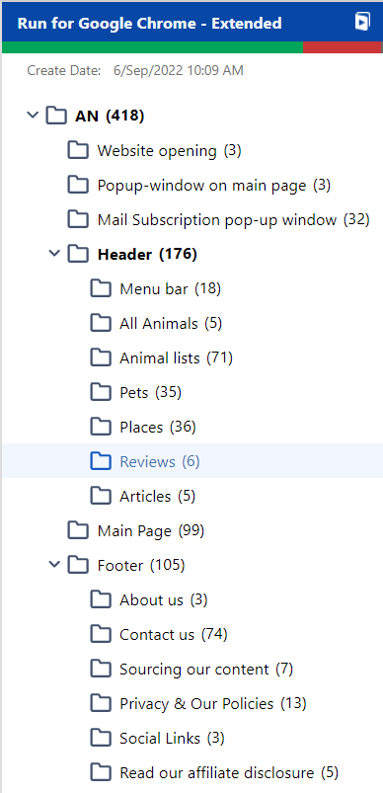
Test documentation:
Check-list
Test plan
TRR
Test-cases

Slide 9
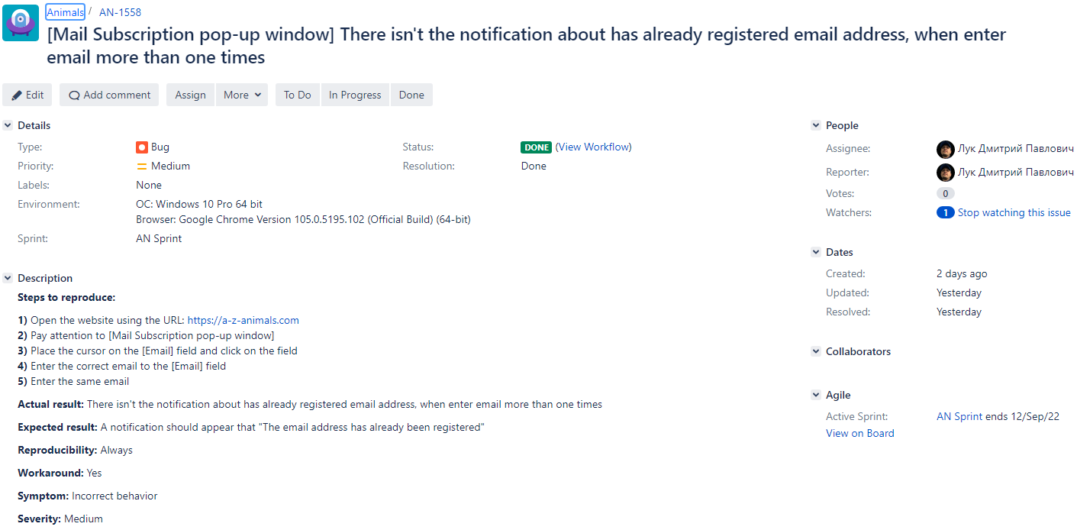
Our bug design looks like this.
The programmer should understand how to reproduce the bug
Click on to view more examples

Slide 10
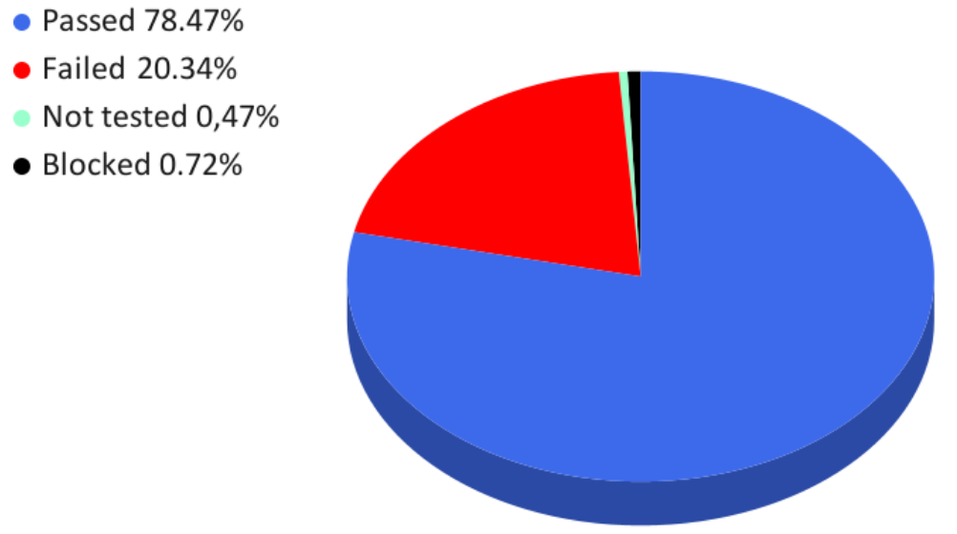
Test case statistics by covered area:
Status | Quantity | Percentage, %
Passed | 328 | 78,47%
Failed | 85 | 20,34%
Not tested | 2 | 0,47%
Blocked | 3 | 0,72%
Total | 418 | 100,00%

Slide 11
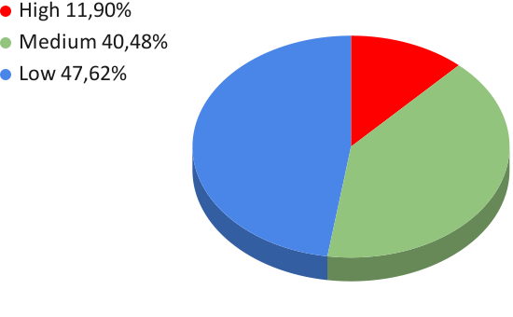
Priority and percentage:
Quantity | Highest | High | Medium | Low
42 | 0 | 5 | 17 | 20
100 % | 0,00% | 11,90% | 40,48% | 47,62%

Slide 12
Resume:
Having tested our website https://a-z-animals.com according to the gray and black box method. We can conclude that the existing errors do not significantly affect the basic functionality. For more convenient use, it is necessary to eliminate existing bugs and conduct a regression test.
We, as a young team of testers, found out that the most important factor affecting the speed and quality of project testing is risks.
We have taken into account the risks of time, the risks of insufficient immersion in the product and subject area, the risks associated with a lack of experience, etc.
The site has a lot of internal pages with descriptions of animals. Many pages have different content filling logic, which is why there are different bugs on seemingly identical pages.

Slide 13
Recommendations:
The site has pages with endless loading of content. We suggest using a pagination on every page of the site.
For faster site navigation, we suggest adding elements that will simplify the transition to the header and footer of the site.
The site has a lot of ad blocks, and this greatly distracts from the main content. It is necessary to allocate separate blocks on the site where advertising on third-party resources will be located.
The secondary functionality of the site is the purchase of goods.
We suggest adding this section to the header of the site, and in the existing review section, post information related only to animals.
Add the ability to go to the YouTube channel of the site in the footer.

Slide 14

The TBE team thanks you for attention!

